Slide 1
SQL VS NOSQL
Dhifaoui Makrem

Slide 2

MONGO DB
MongoDB belongs to the family of NoSQL databases which is used for storing unstructured documents in JSON format
NoSQL databases like MongoDB are used to save unstructured data.
MongoDB does not support advanced analytics and joins like SQL databases support.

Slide 3
FUNCTIONALITIES
There are multiple search options in MongoDB , including field , range , and regular expression categories .
Any area can index documents .
A load balancing configuration is automatically implemented because the
data is split into shards .
It provides tools for map reduction and aggregation .
The code is written in JavaScript instead of Procedures

Slide 4

SQL
MySQL is an open-source SQL relational database, which is used for storing structured data in a table-like format.
They provide various features for accessing ,adding, managing ,and processing data
It is a Database System that is easy to use

Slide 5
FUNCTIONALITIES
A SQL function is usually more reliable than an equivalent external function
Provide input parameters
Scalar SQL functions return numerical values
A SQL operation can easily be implemented using SQL procedural language statements and features

Slide 6
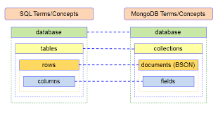
MongoDB VS SQL
SQL databases are used to store structured data while NoSQL databases like MongoDB are used to save unstructured data

